Slide 1
Enhancement for Text Placement
Proposal by Hugh Astle Teledyne CARIS
S-100 TSM8 March 2-4 2021

Slide 2
Text Placement
Separate placement point feature with location used to place text for an associated real feature
Works well with placement of text for area and line features
Problematic for Point features
  When zooming in the text appears to move away from the real feature
  When zooming out the text appears to move closer to the real feature
  Solution: For Point features use Real point location for Text Placement feature and add an offset x,y to place the text in mm on the display with reference to the real feature.

Slide 3
Text Placement - Problem
On a course up (rotated) display the x,y, offset doesn’t work well.
The CRS options are geographic (metres on the ground) or Portrayal Y up.
  The chart is rotated but the CRS for portrayal is not
  Adding a new North rotated portrayal CRS confusing to handle

Slide 4
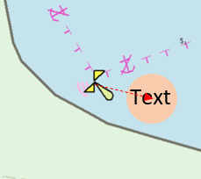
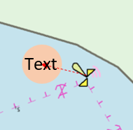
Text Placement - Solution
Simpler to define the offset using a bearing and distance
  Bearing is geographic (compass) concept is familiar
  Distance is mm on the display
Text will rotate at point defined by the bearing and distance.
North Up, Text East of Feature
North Up, Text East of Feature

Slide 5
Text Placement - Actions
Enhance S-100 Part 9 portrayal to add a new offset type which uses a bearing and distance.
  The existing x,y offset is still available
  Offset is an optional parameter when drawing text or symbols
Add bearing and distance attributes to TextPlacement feature in DCEG
  Remove flipBearing attribute. It is not well understood or easy to implement.

Slide 6
Thank You

